Slide 1

MAHENDRA INSTITUTE OF TECHNOLOGY
DEPARTMENT OF ELECTRONICS AND COMMUNICATION ENGINEERING
TEAM NAME: TECH BOYS
IOT BASED SMART IRRIGATION SYSTEM

Slide 2





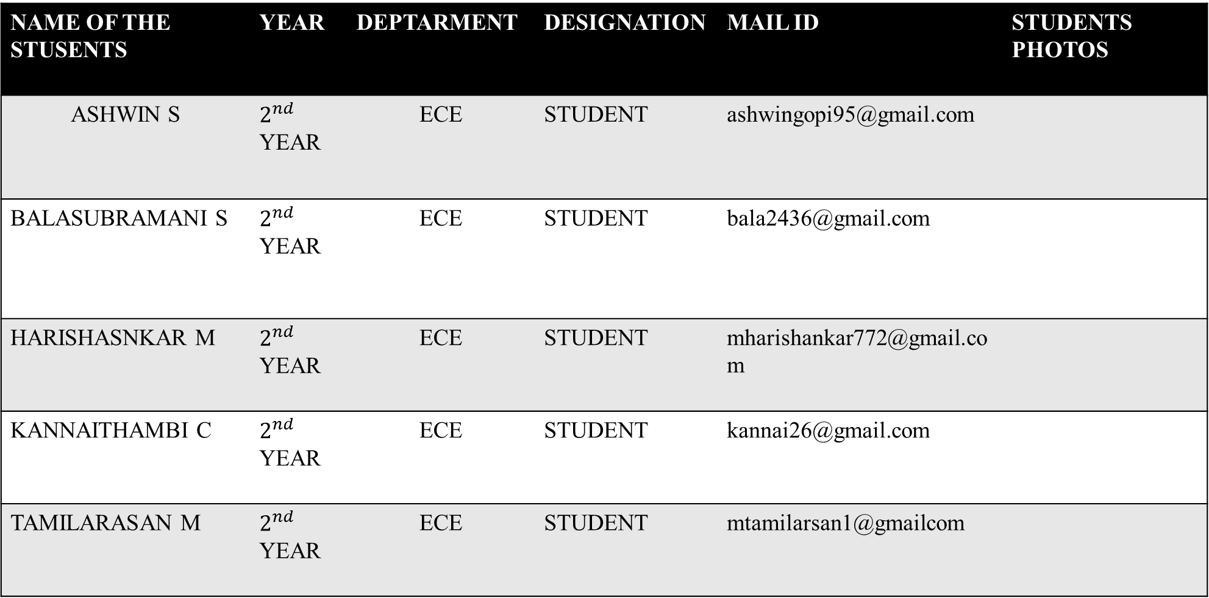
CREW DETAILS
NAME OF THE STUSENTS | YEAR | DEPTARMENT | DESIGNATION | MAIL ID | STUDENTS PHOTOS
ASHWIN S | $2^{nd}$ YEAR | ECE | STUDENT | ashwingopi95@gmail.com
BALASUBRAMANI S | $2^{nd}$ YEAR | ECE | STUDENT | bala2436@gmail.com
HARISHASNKAR M | $2^{nd}$ YEAR | ECE | STUDENT | mharishankar772@gmail.com
KANNAITHAMBI C | $2^{nd}$ YEAR | ECE | STUDENT | kannai26@gmail.com
TAMILARASAN M | $2^{nd}$ YEAR | ECE | STUDENT | mtamilarsan1@gmailcom

Slide 3
ABSTRACT
Smart Agriculture Developing Model is a real -time monitoring system. It monitors the soil properties like temperature, humidity, soil moisture, pH, etc. It is possible to control many operations of the field remotely, from anywhere, anytime by IoT.
A smart irrigation system uses sensors and data analysis to optimize watering schedules, saving water and energy while potentially improving crop yields compared to traditional methods.

Slide 4
IOT(INTERNET OF THINGS)
The Internet of Things ( IOT ) is the physical objects of “ things” embedded with electronics, software, sensors and network connectivity, which enables these objects to collect and exchange data.
IOT allows objects to be sensed and controlled remotely across existing network infrastructure, creating opportunities for more direct integration between the physical world and computer –based systems and resulting in improved efficiency, accuracy and economic benefits.

Slide 5
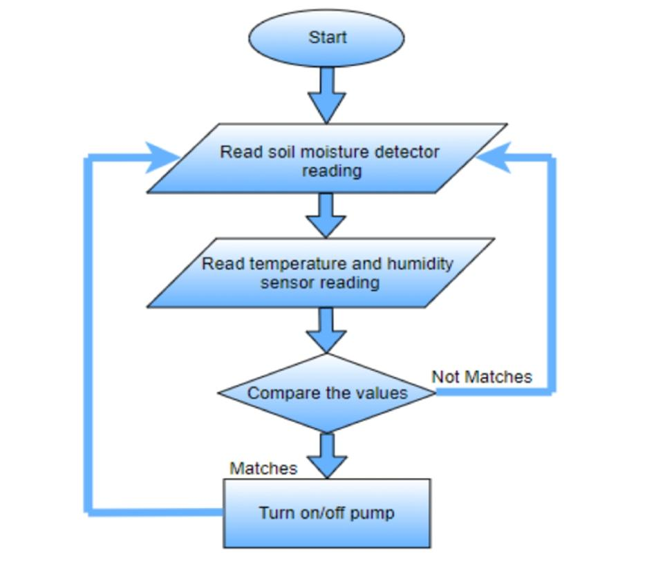
FLOWCHART:

Slide 6
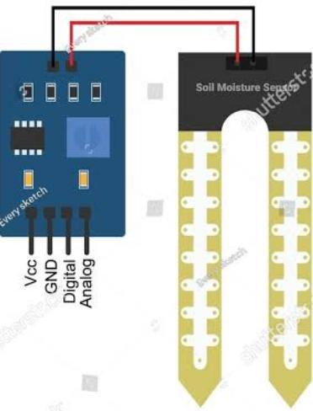
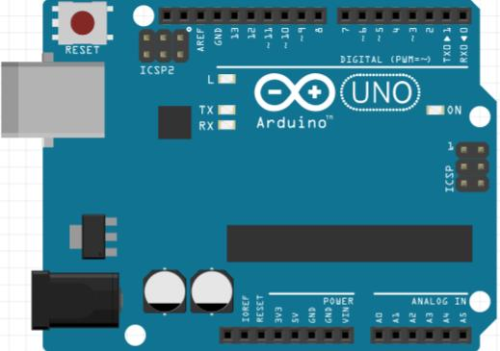
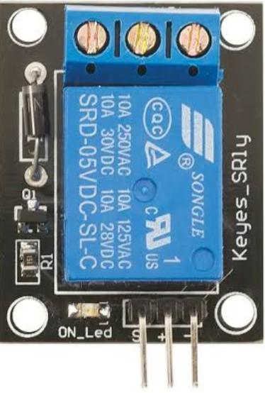
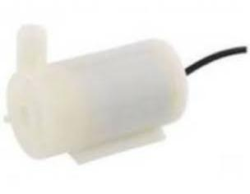
REQUIREMENTS OF THE PROJECT :
ARDUINO UNO
SOIL MOISTURE SENSOR
WATER PUMP
RELAY MODULE
BATTERY

Slide 7
ALGORITHM FOCUSSED
In IoT-based smart irrigation systems, algorithms analyze sensor data (soil moisture, temperature, humidity) to optimize watering schedules, enhancing crop yield and conserving water. Techniques include fuzzy logic for adaptive control and neural networks for predictive analytics.

Slide 8
ADVANTAGES
Increase in productivity
Reduced water consumption
To safe to operate
No manpower required
Reduced soil erosion and nutrient leaching.
APPLICATIONS
Useful in Irrigation Field
Useful in Parks and Grounds
It is also helpful in paddy areas and rice fields
It is beneficial in Pisciculture

Slide 9
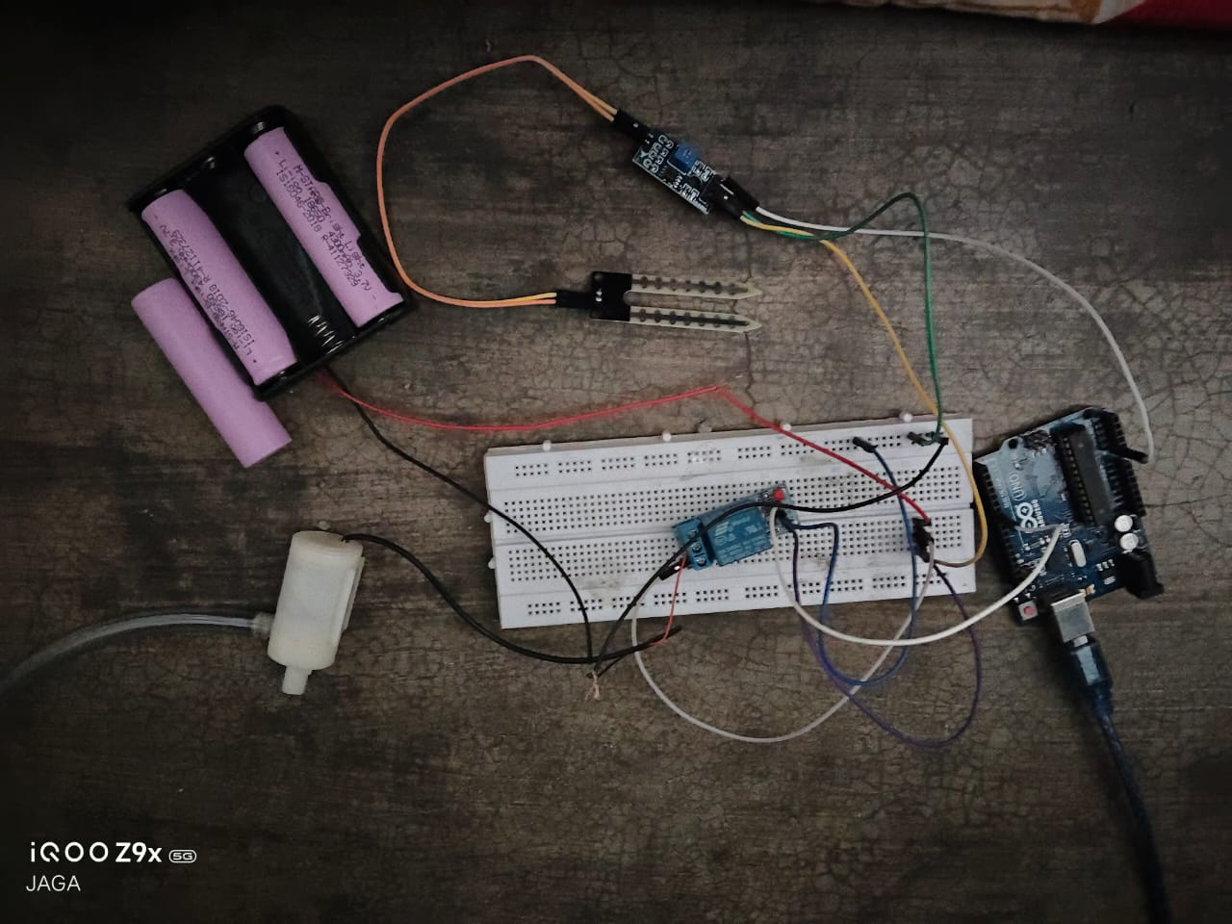
DEMONSTRATION

Slide 10
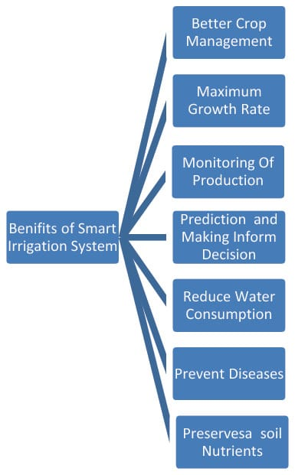
EXPECTED OUTPUT

Slide 11
CONCLUSION
IoT-based smart irrigation systems offer significant benefits for agriculture including water conservation, improved crop yields, reduced labor costs and enhanced efficiency through real-time data monitoring and automation.
FUTURE SCOPE
Using this system as framework, the system can be expanded to include various other options which could include mobile application control of motor and wifi controlled monitoring. These will expand the working capability and efficiency of this prototype.

Slide 12


